Slide 1
Findley Lake Water Quality
Melanie Wright, P.E.
NYSDEC Division of Water, Region 9
September 19, 2022

Slide 2
DEC’s Regulatory Role
DEC monitors and evaluates water quality in lakes and streams across the state.
Class B
Primary Contact Recreation
Phosphorus
Guidance Value = 20 µg/L

Slide 3
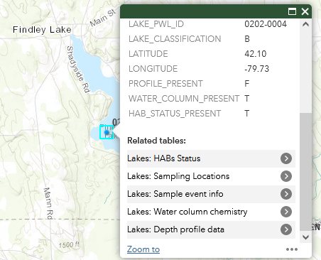
Water Quality Monitoring
Citizens Statewide Lake Assessment Program (CSLAP) volunteer program through DEC and NYSFOLA.
DEC monitors lakes that are not in the CSLAP program every five years.
Data is available online through the Water Monitoring Data Portal.

Slide 4
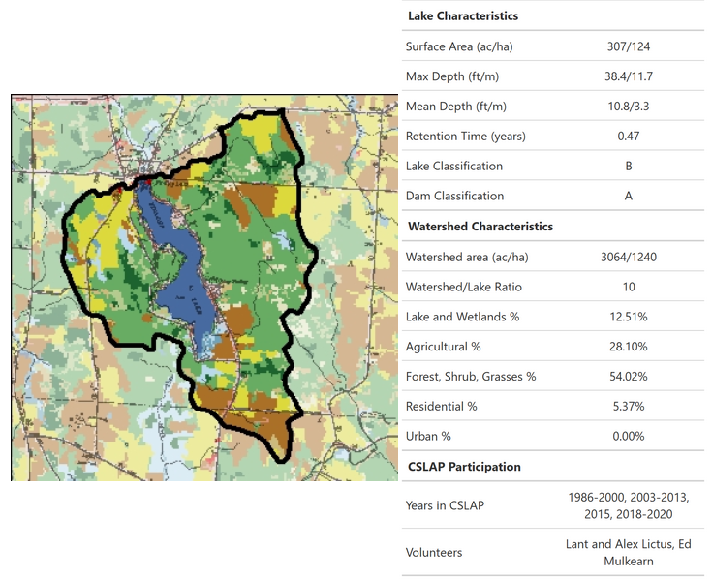
2020 CSLAP Report
Recent CSLAP reports are available for download on DEC’s website.

Slide 5
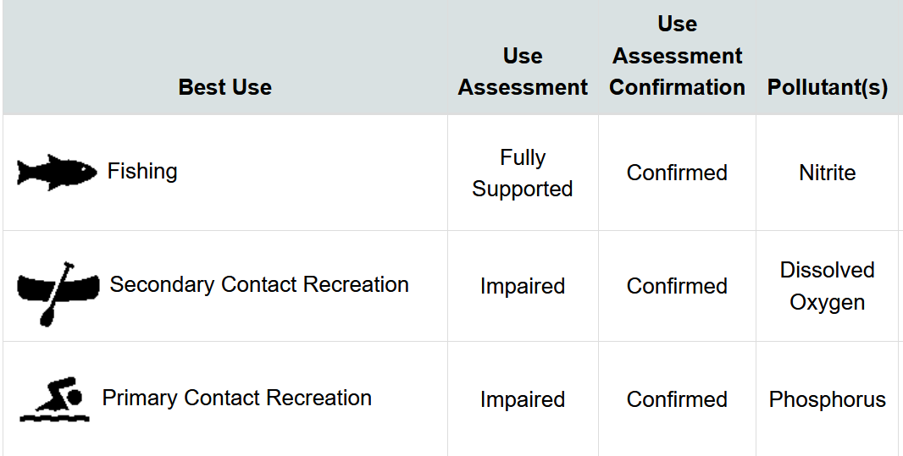
Water Quality Assessment
Findley Lake’s best use is primary contact recreation (swimming).
The lake is impaired for primary contact recreation based on CLSAP data (phosphorus > 20 µg/L).
Fact sheet is available online through DECinfo Locator.

Slide 6
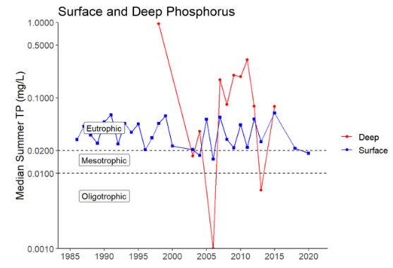
Long-term Phosphorus Trends
No meaningful statistical change in long-term surface or deep phosphorus concentrations since 1986.
Source: 2020 CSLAP Report

Slide 7
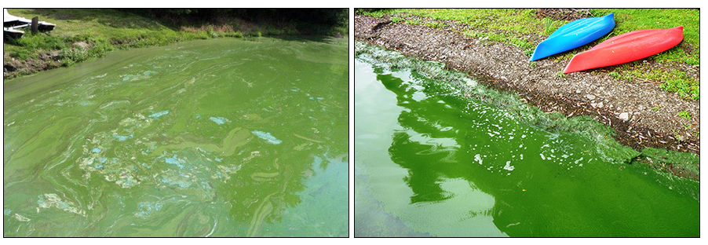
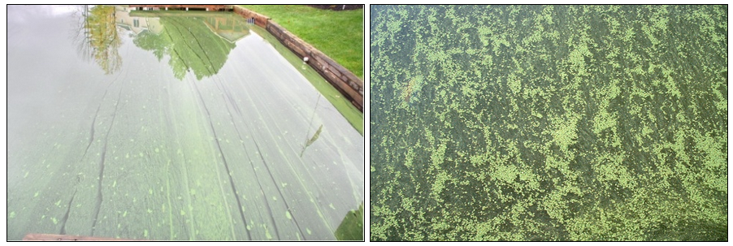
Harmful Algal Blooms (HABs)
Harmful Algal Blooms were documented in the lake in 2020 and 2021.
HABs are likely triggered by a combination of water and environmental conditions: excess nutrients (phosphorus and nitrogen), lots of sunlight, low-water or low-flow conditions, calm water, and warm temperatures.
Can produce toxins that can cause illnesses or be fatal to pets and children.

Slide 8
2008 TMDL (Total Maximum Daily Load)
Watershed-based approach that outlines a strategy to improve water quality.
TMDL for Phosphorus in Findley Lake published Sept. 2008.
Available on DEC website.
TMDL documents:
Pollutant sources and loads
Allowable pollutant levels
Actions that will improve water quality

Slide 9
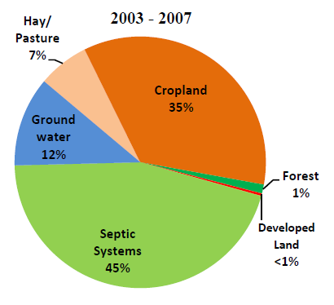
TMDL
Phosphorus sources:
Estimated using modeling software.
Uses 2000 Census population data
and 2007 land use and water quality data.
Note that internal loading was not considered in the analysis.

Slide 10
Phosphorus Loading from Septic Systems
TMDL assumption: Within 50’ of the shoreline, 100% of septic systems are “short circuiting.” Between 50’ and 250’, 50% are short circuiting.
Definition: Systems in close proximity to surface waters where there is limited opportunity for phosphorus adsorption to take place.
Enhanced treatment for phosphorus may be feasible. Costs and parcel sizes may be limiting factors.

Slide 11
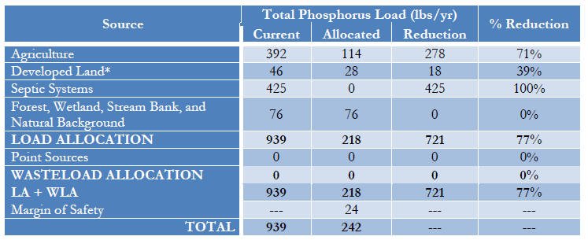
TMDL

Slide 12
TMDL
Recommendation for phosphorus loading from septic systems (pg. 21):
“Due to the fact that septic systems are a major source of loading in the Findley Lake Watershed, restoration depends on elimination of that source. A systematic approach, such as the formation of a sanitary sewer district and discharge of treated wastewater outside of the watershed, is essential to achieving the load reductions specified above.”
Interim recommendation: “A surveying and testing program should be implemented to document the location of septic systems and verify failing systems requiring replacement.”

Slide 13
Chautauqua County Health Department’s Role
Septic system inspection program and repair/replacement mandates.
Septic System Replacement Fund oversight.
Findley Lake is a qualifying area due to documented impairment.
Reimbursement of 50% of replacement costs, up to $10,000.
Installation of enhanced treatment technologies qualifies.

Slide 14
In-Waterbody Treatments
In-waterbody treatments may be effective to reduce internal phosphorus loading.
Treatments may be expensive and would require permits from DEC.
Funding is available through DEC’s NPS planning grant and WQIP for aeration systems, hypolimnetic withdrawal, and dredging.
Requires documentation prepared by a qualified professional that identifies significant internal loading.

Slide 15
Other Phosphorus Sources
Pieces of the puzzle. A multi-faceted approach is needed.
Control of agricultural runoff via management practices.
DEC CAFO program
Agricultural Environmental Management (AEM) program – Chautauqua County SWCD.
Town applied for several DEC grants this year to fund studies on surface runoff, sediment loading caused by failing/undersized culverts, and in-lake control of nutrients.
Awards will be announced in December.

Slide 16
Water Quality Improvement Program (WQIP)
Annual DEC grant program
Applications typically accepted from May to July.
“Municipal Systems to Serve Multiple Properties with Inadequate On-site Septic Systems” is a high priority funding category as of 2022.
Awards up to $10M, with 25% required match.

Slide 17
Conclusions
100% of phosphorus loading from septic systems must be eliminated to meet the TMDL goals.
May or may not be feasible without sewering the lake.
DEC cannot mandate that the Town install sewers.
Phosphorus reduction will have many benefits.
Improved water quality and aesthetics for recreational purposes
Maintaining the lake’s value for tourism
Reduced danger to pets and kids from potential HAB toxins

Slide 18
Thank you! Questions?
Melanie Wright, P.E.
Professional Environmental Engineer 1
NYSDEC Region 9 Division of Water
700 Delaware Avenue, Buffalo, NY 14209
melanie.wright@dec.ny.gov
Connect with us: Facebook: www.facebook.com/NYSDEC Twitter: twitter.com/NYSDEC Flickr: www.flickr.com/photos/nysdec

